Slide 1
Detecting Shill Bidding Networks in Online Auctions: A Multi-Algorithm Graph Analysis Approach Using Neo4j
Team: Min Yang, Micah Collins, Kakit Ho, Nicole Zhang
University of California, Berkeley
April 2025
Link to Github Repo: https://github.com/mids-w205/project-3-hkk261/tree/main

Slide 2

Topic of Interest & Relevance
The Challenge: Online auction platforms face significant threats from sophisticated fraud schemes, particularly shill bidding rings that artificially inflate prices and undermine marketplace integrity.
Traditional Limitations: Relational databases struggle to efficiently analyze the complex interconnected relationships that reveal collusive bidding networks.
Why Neo4j?: Neo4j is a leading NoSQL graph database designed specifically to store and process connected data, making it ideal for our project because its native graph structure excels at uncovering hidden relationships and suspicious patterns in auction networks where connections between entities reveal fraudulent activity.
Our Approach: Leveraging Neo4j graph database capabilities to model and analyze the intricate relationships between bidders and auction activities.

Slide 3
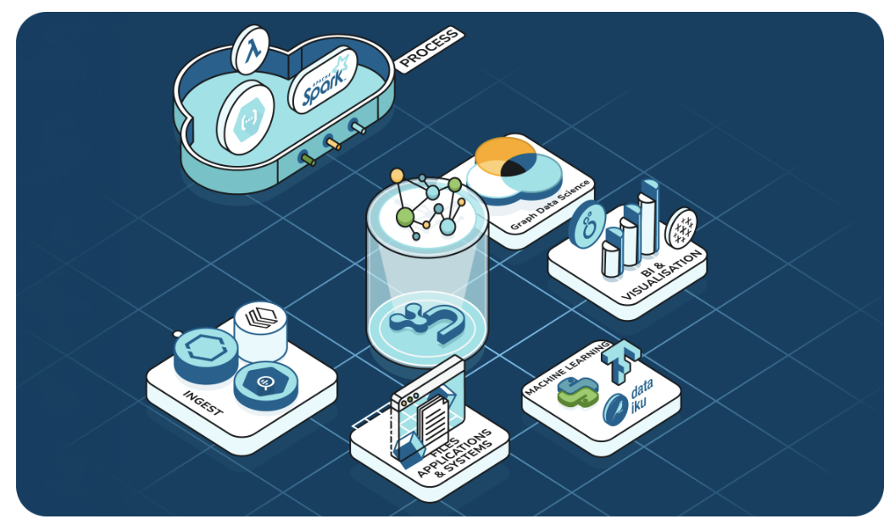
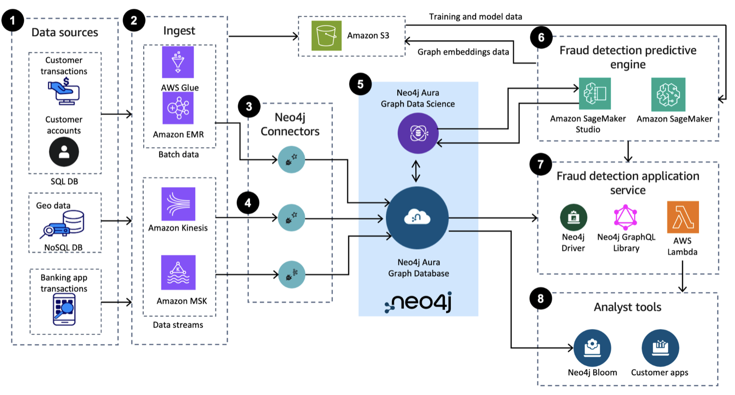
The Graph Advantage for Online Auction Fraud Detection
Why Graph Analysis for Auction Fraud?:
Bidding rings leave behind unique network patterns that graph databases naturally expose
Neo4j reveals the "hidden connections" between seemingly unrelated bidders
Traditional SQL joins are inefficient for multi-step collusion detection
RDBMS is schema inflexible for storing evolving auction data
Project-Specific Benefits:
Map bidder interactions across auctions to spot recurring behavior
Identifies suspicious bidding sequences where shill bidders never win but inflate prices
Tracks timing patterns as relationship properties
Visualizes coordinated bidding behavior that suggests collusion
Real-World Application:
Find accounts that repeatedly “hand off” bids to one another
Flag bidders who consistently outbid others but drop out before the end
Quantify relationship strength based on shared auction activity

Slide 4
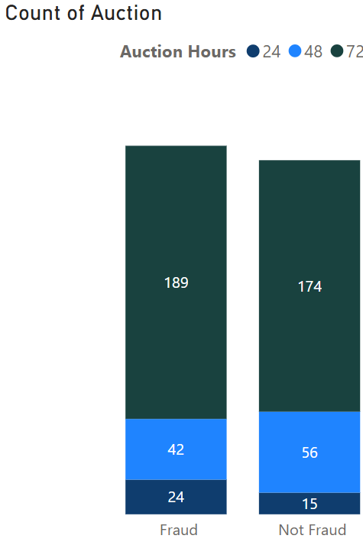
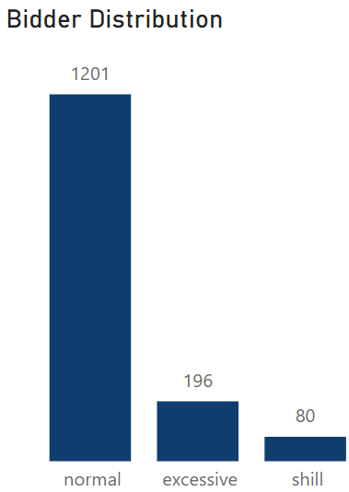
Online Auction and Bidder Data Simulation
Realistic Simulation Based on Industry Research:
Comprehensive research into mainstream platforms like eBay to
model authentic auction dynamics
Simulation designed to mirror real-world bidding patterns and behaviors
Simulated as an alternative to protected confidential transaction data
Simulation Architecture:
500 simulated auctions (auction_001 to auction_500)
Pool of 1,500 bidders with behaviorally distinct profiles:
82% Normal bidders
12% Excessive bidders
8% Shill bidders with known shill bidder labels as ground truth
Behavioral Modeling:
Shill Bidders: Start aggressive (94% bid probability), decrease to 10% → mimic price inflation without winning
Excessive Bidders: Very active but legit → bid rate grows from 30% to 80%
Normal Bidders: Low, steady bids, spike at end → typical user behavior
End-auction Sniping: Final-round bidding spike → modeled for normal and excessive bidder type
Notes:
Micah Present In our scenario, we were not given a dataset, we were expected to generate one.
So to capture realistic e‑commerce dynamics, we simulated an entire auction-bidder ecosystem, modeling 500 independent auctions with 1,500 unique bidders,
allowing for with many layers of non-deterministic and emergent behavior.
Each auction has up to 3 shill bidders, who will work together to drive up the auction price, will last anywhere from 15 to 40 rounds, and have from 10 to 23
participants.
The 6% of bidders who are secretly shills are also all part of 4 secret shill communities who only participate with each other, modelling how a hidden gang
would operate and collude together.
There is also a sophisticated system for calculating the timestamp and order of each bid in an auction based on the strategies of each bidder.
The person who places the last bid on an auction is the winner.
In terms of graph data structure, we have bidder nodes with a connection for each bid in every auction they participate in.
There are 3 types of bidders:
Normal bidders make up roughly 82%—they mainly bid when an auction is not quite fresh, but not late stage either, steady bids with a late‑auction spike.
Excessive bidders represent about 12%—willing to bid higher and invested in securing the victory, ramping their bidding rate from around 30% early on to 80% in later rounds.
Shill bidders comprise the remaining 6%—their behavior is our ground truth for fraud detection, they bid mainly in the beginning and middle of auctions, but almost never at the end in order to avoid winning the auction.

Slide 5
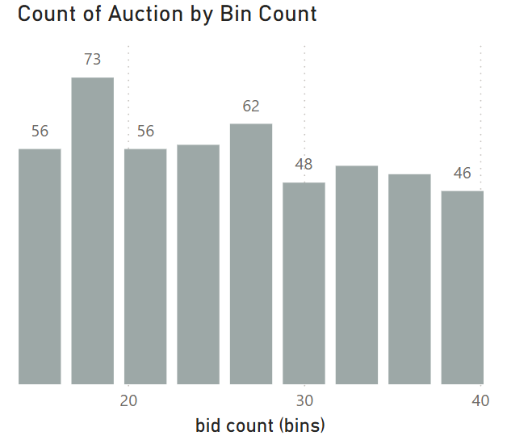
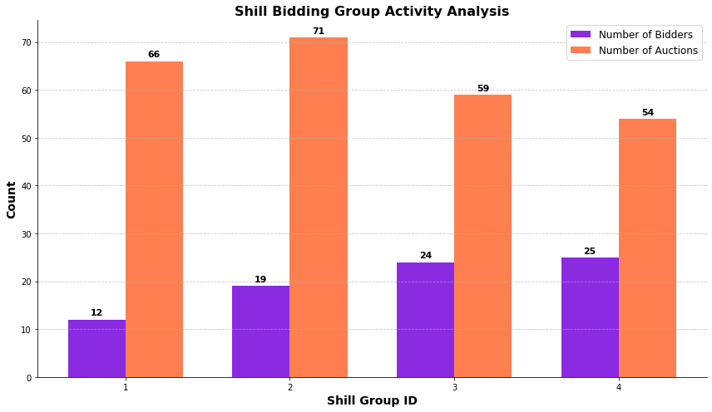
Exploratory Data Analysis (EDA): Auction Data & Shill Group Behavior

Slide 6
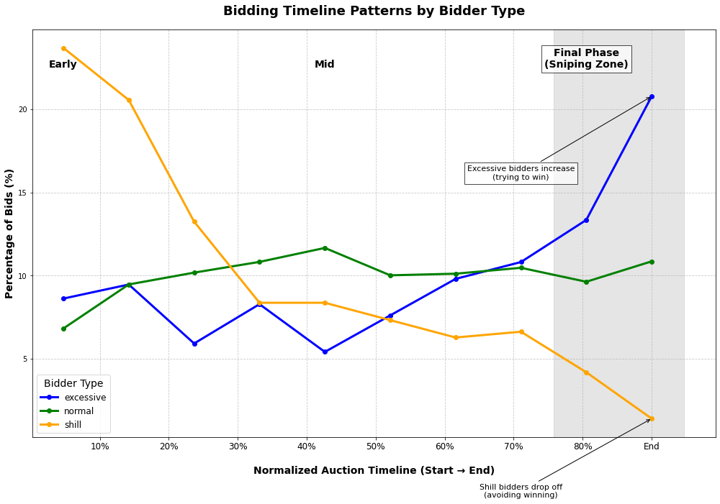
EDA - Bidding Timeline Pattern by Bidder Type
🟩 Normal Bidders (Green Line)
Relatively even distribution of bidding
Casual sniping behavior in final rounds
Represent a baseline pattern of healthy, typical user engagement
🟦 Excessive Bidders (Blue Line)
Steady rise in activity throughout the auction timeline
Noticeable spike in the final phase (Sniping Zone)
Reflects behavior of aggressive or competitive bidders who may be legitimate but intense
🟧 Shill Bidders (Orange Line)
Extremely active early on, possibly to create bidding momentum and artificially inflate price
Activity drops sharply mid-to-late auction, especially in the final rounds — avoid winning the auction
Clear drop-off in the sniping phase, intentionally avoiding wins and focusing on inflating prices

Slide 7
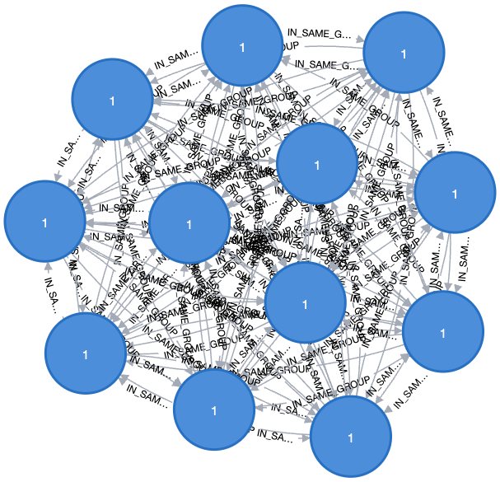
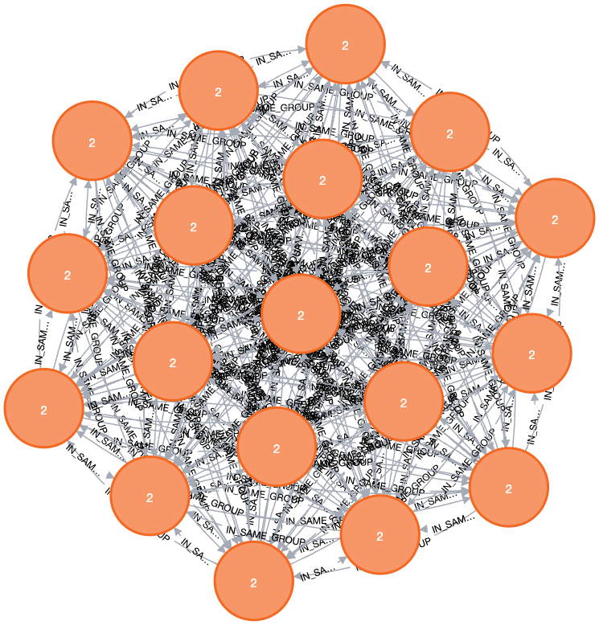
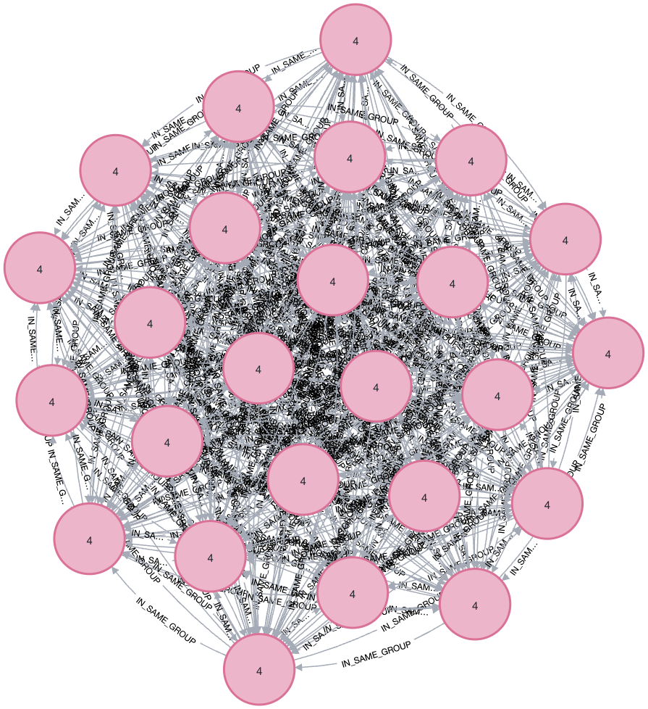
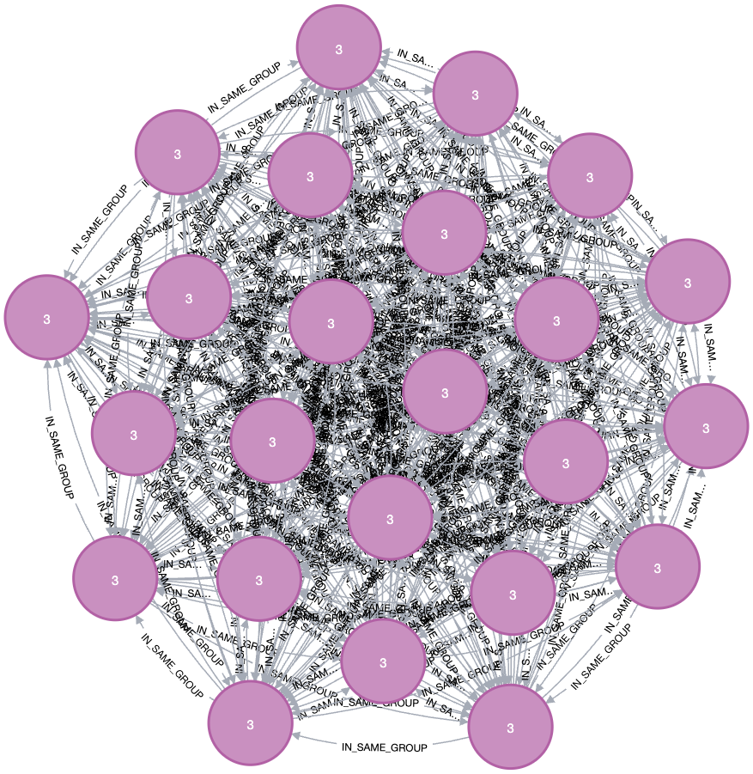
Neo4j Visualization 1: Detecting Shill Bidding Rings
Key Observations
The bidders are clearly clustered by their shill group value, instantly revealing coordinated bidding rings
The clusters form completely separate networks with no cross-connections - a pattern that would trigger immediate investigation in real auction platforms
Each group forms a "complete clique" pattern where every member connects to every other member - a distinctive signature of fraudulent coordination impossible to detect with traditional databases
Individual bidder IDs provide identity information for investigation and tracking of suspicious actors across multiple auctions

Slide 8
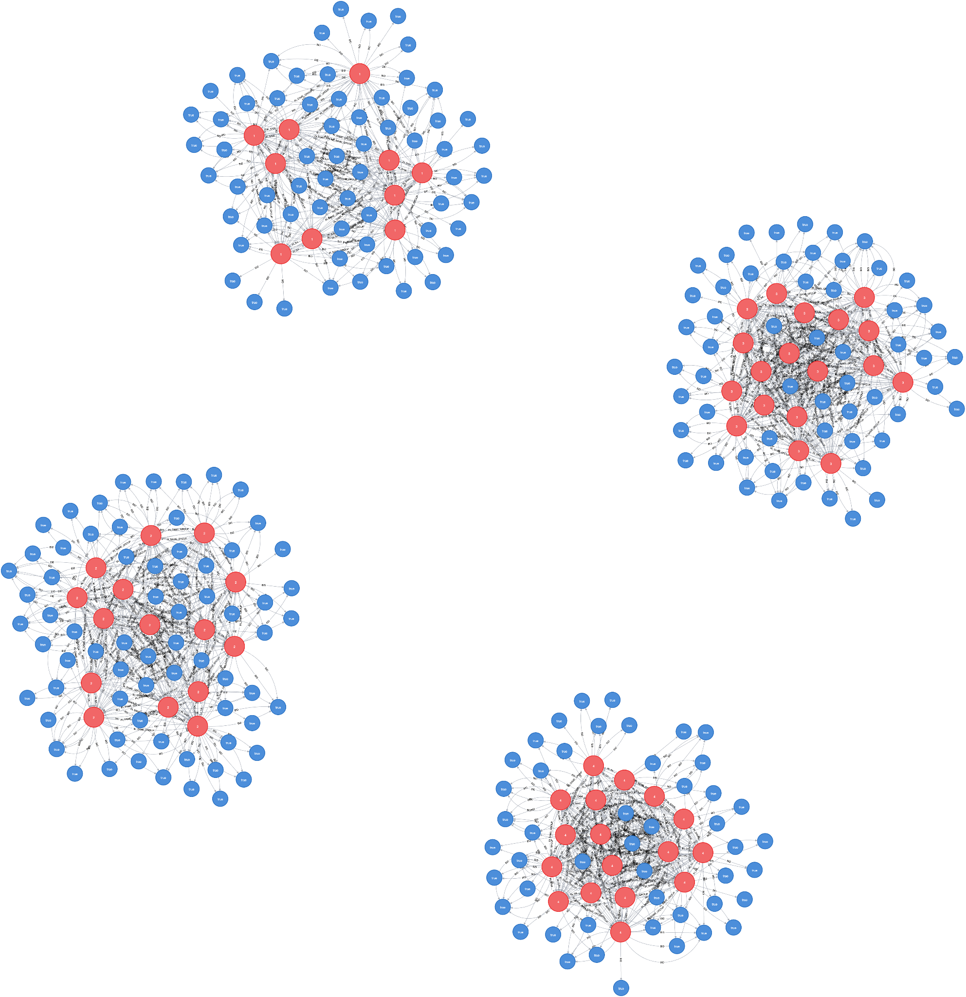
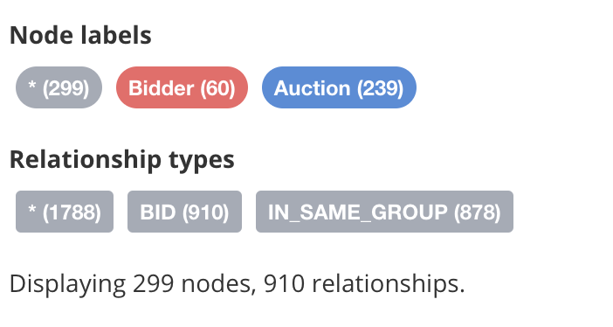
Neo4j Visualization 2: Shill Bidding Auction Activities
What We're Seeing:
Red nodes: Shill bidders
Blue nodes: Fraudulent auctions
"BID" relationships: Show which bidders participated in which auctions
Business Insights:
Shill bidders from the same group target specific auctions together
Multiple members of a shill ring rarely bid on the same auction as members from other rings
Certain auctions attract multiple shill bidders, indicating coordinated price manipulation

Slide 9
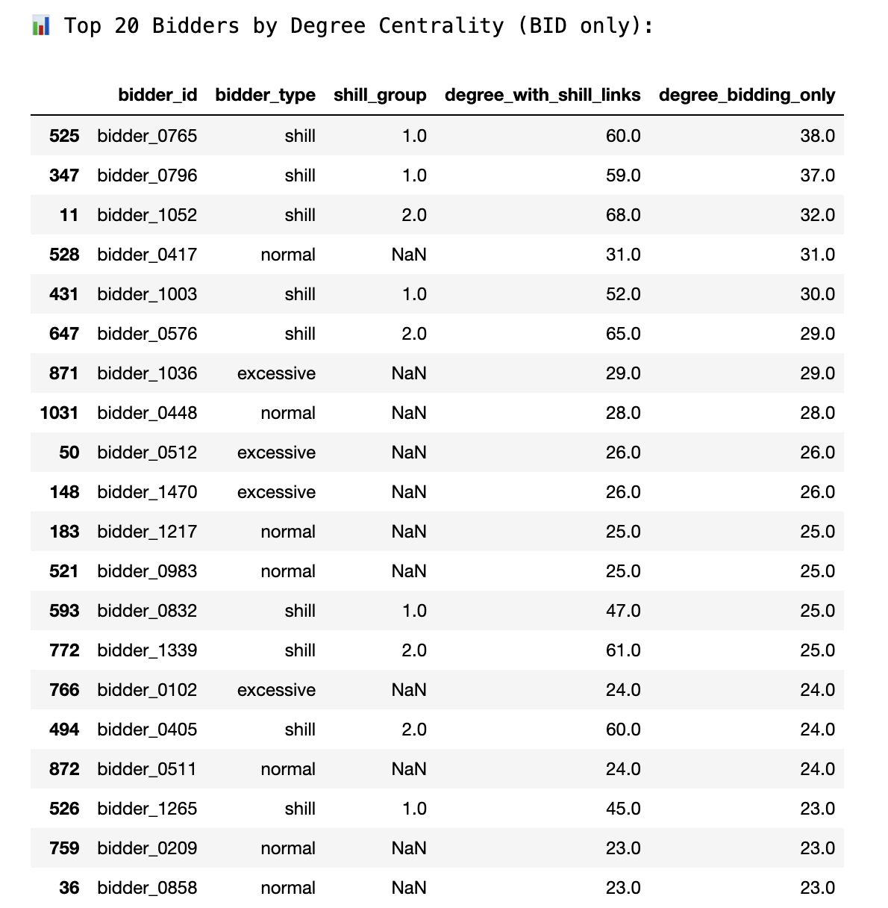
Graph Algorithm 1: Degree Centrality by Bid Only
Degree centrality is calculated by summing outgoing links from bidders to auctions, which captures the total number of bids placed by each bidder across all auctions.
This serves as the primary indicator of potential shill behavior because shill bidders tend to bid more frequently across auctions to drive up prices and manipulate outcomes.
High centrality values highlight bidders who are most active, providing a strong signal for deeper investigation into bidding patterns, especially when combined with other behavioral features.

Slide 10
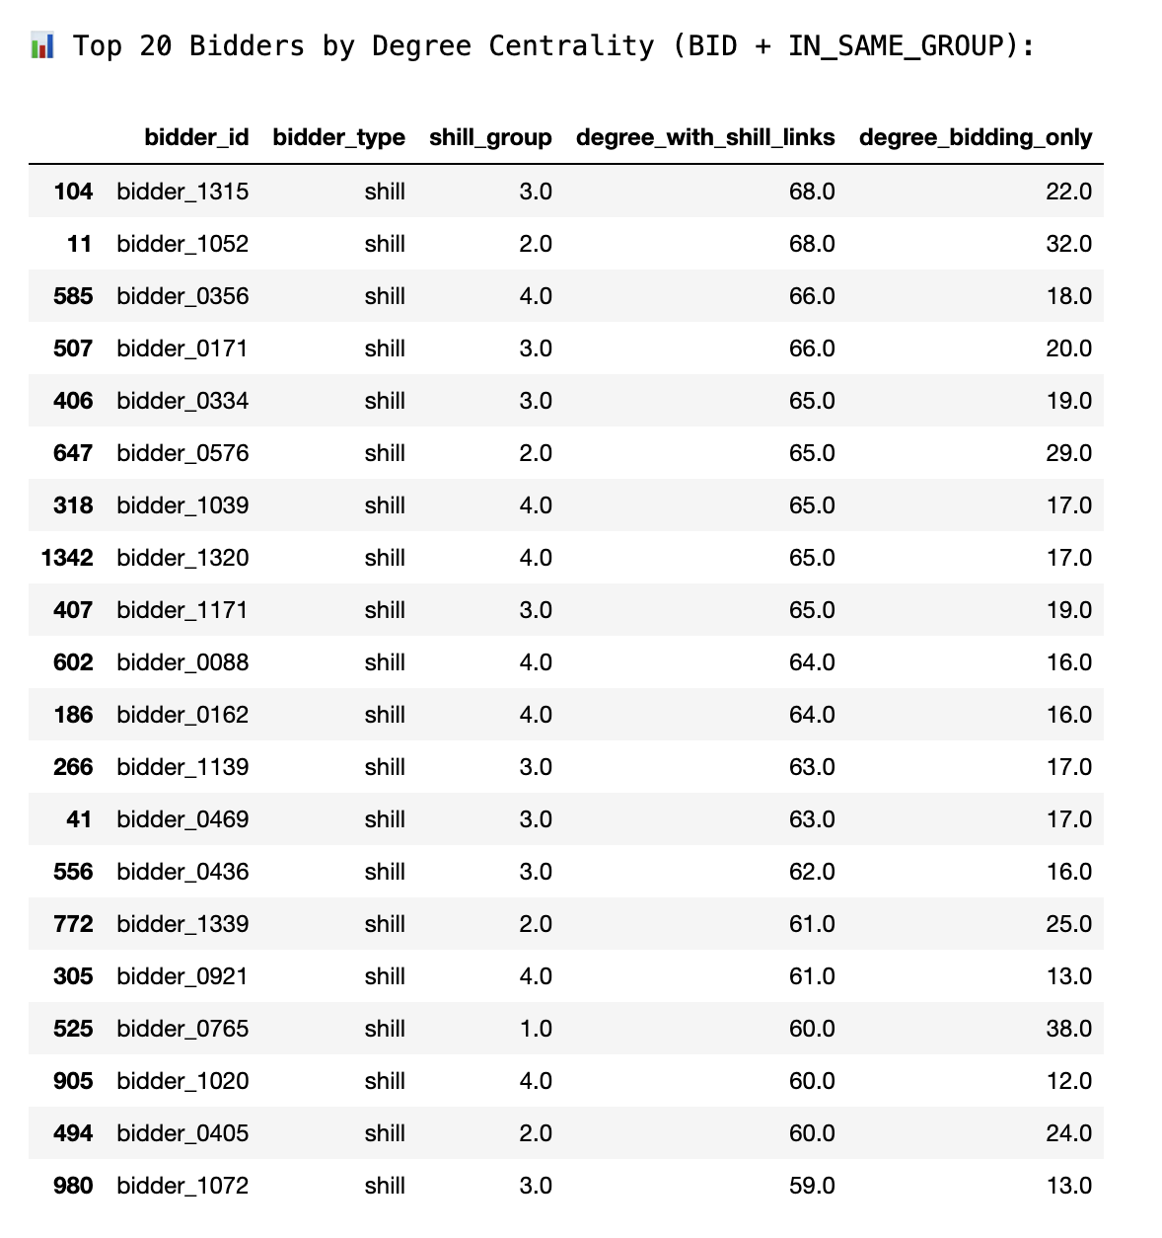
Graph Algorithm 1: Degree Centrality by Shill Links
Degree centrality is calculated by summing outgoing links from bidders to auctions, plus connections to other bidders within the same shill group (IN_SAME_GROUP).
This graph reflects coordinated bidding behavior, where a bidder is linked not only by auction participation but also by group membership, which simulates known or suspected collusion.
While not used as the primary indicator, this enhanced view helps reveal the structure and density of potential shill networks—providing supporting evidence of suspicious collaboration among bidders.

Slide 11
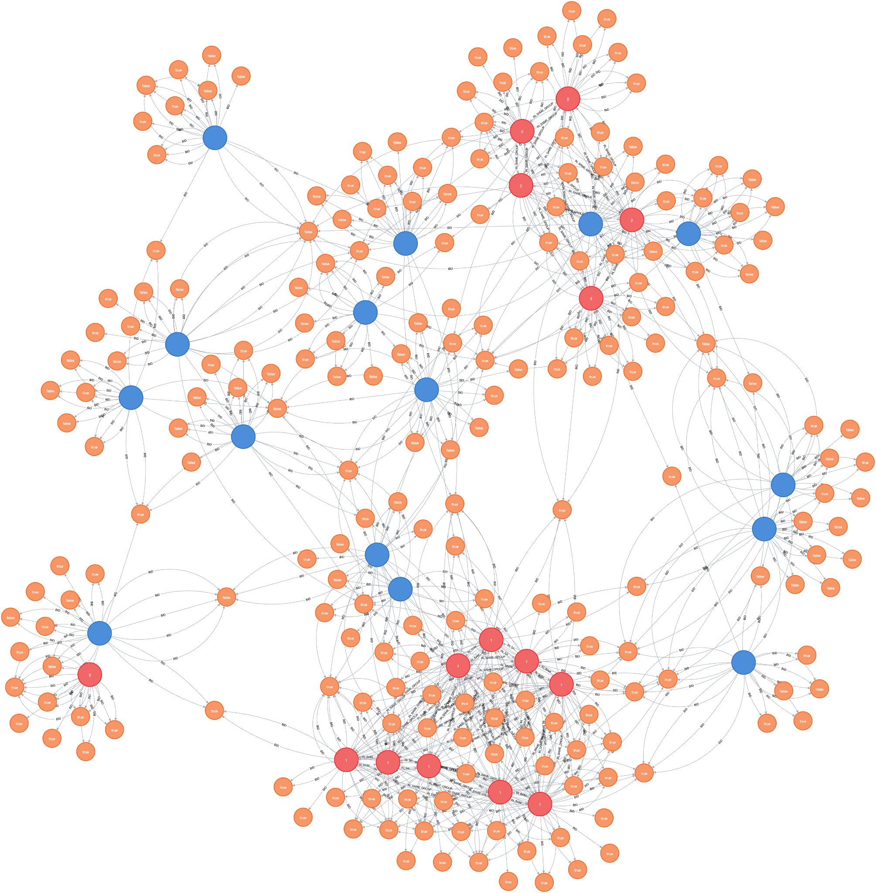
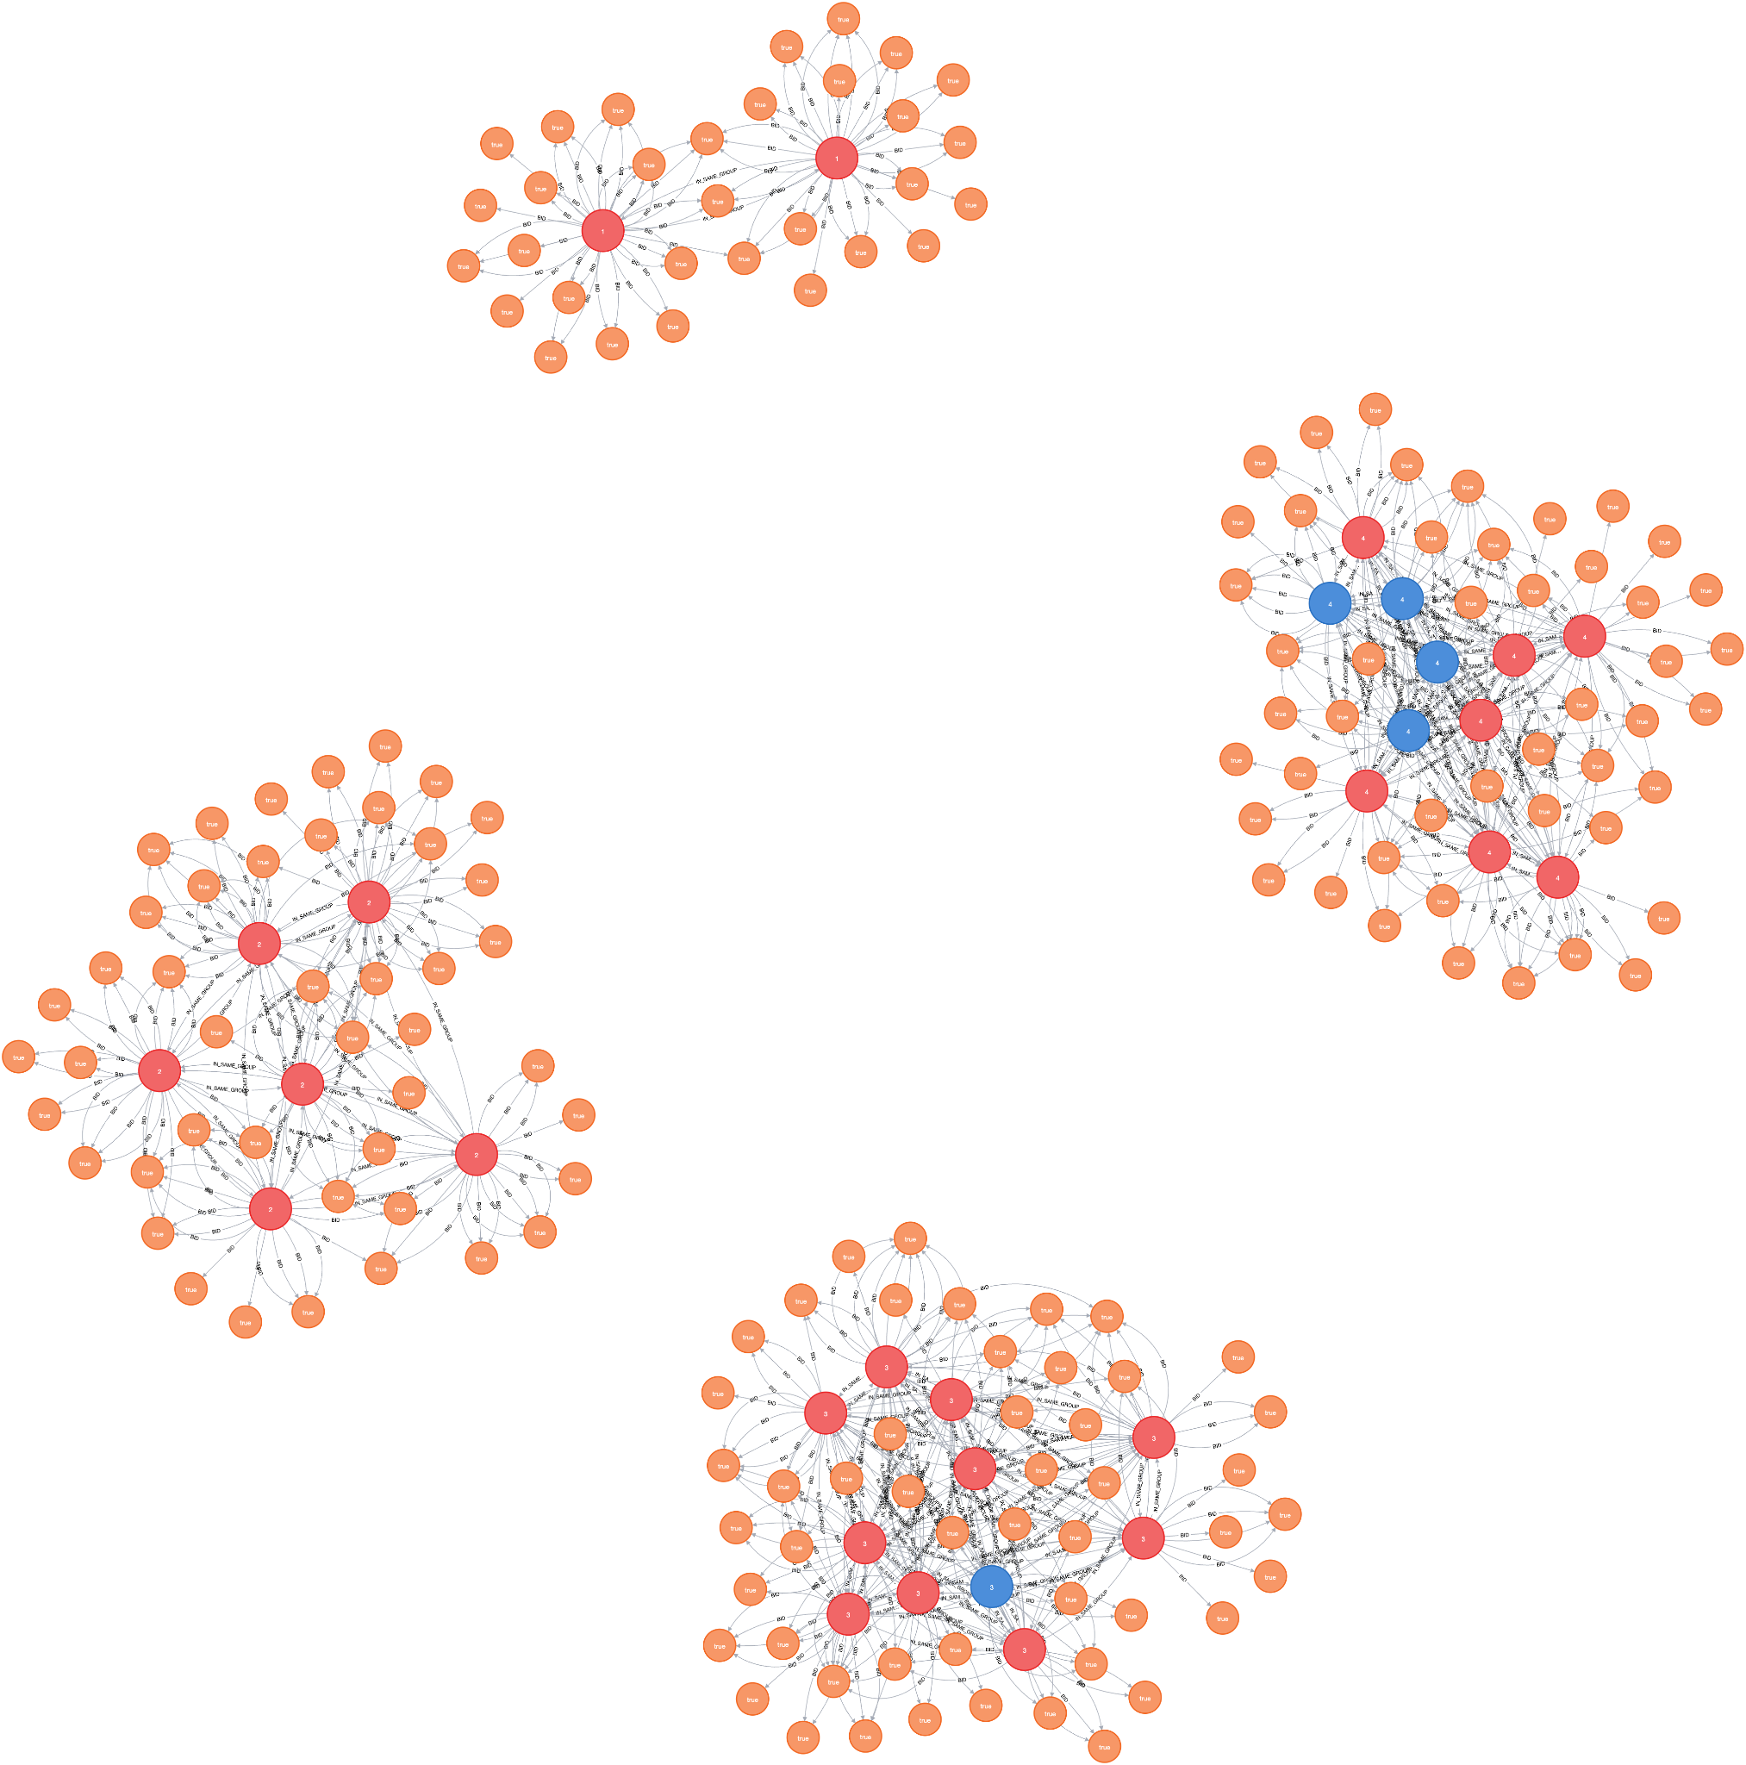
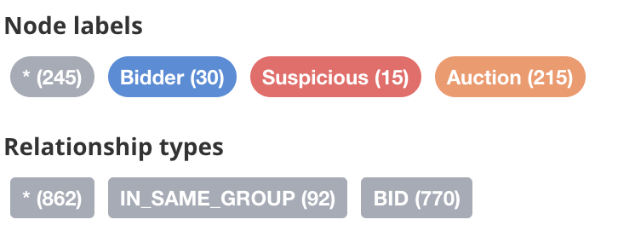
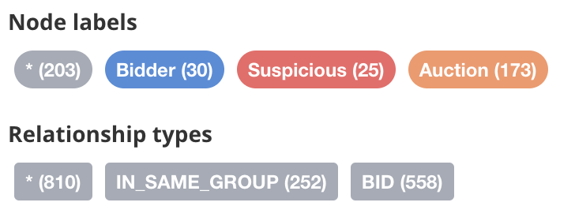
Top 30 Bidders with Highest Centrality Degree Scores
Top 30 Bidders by BID-ONLY Degree:
Top 30 Bidders by Shill-Boosted Degree:
Top Bidders by BID-Only Degree Centrality
Blue nodes - Non-shill bidder - scattered and act independently. Do not exhibit strong clustering
Red nodes - Shill bidder - show strong connectivity, forming noticeable clusters, suggesting strong coordinate behavior
Top Bidders by Shill-Boosted Degree Centrality
Red nodes - Shill bidder - form tightly connected clusters, clearly revealing collusion within shill groups
Each shill group is separated - operate in isolation
Blue nodes - some normal/excessive bidders appear inside shill groups, likely they unknowingly participate in auction dominated by shill rings
Future Value for Detecting Shill Bidders:
Identify bidders with unusually high degree centrality
Detect dense bidder clusters indicative of collusion
Spot bidders with many bids, many connections, but few wins
Enable machine learning models to learn from graph patterns
Build a risk scoring system for proactive fraud monitoring

Slide 12
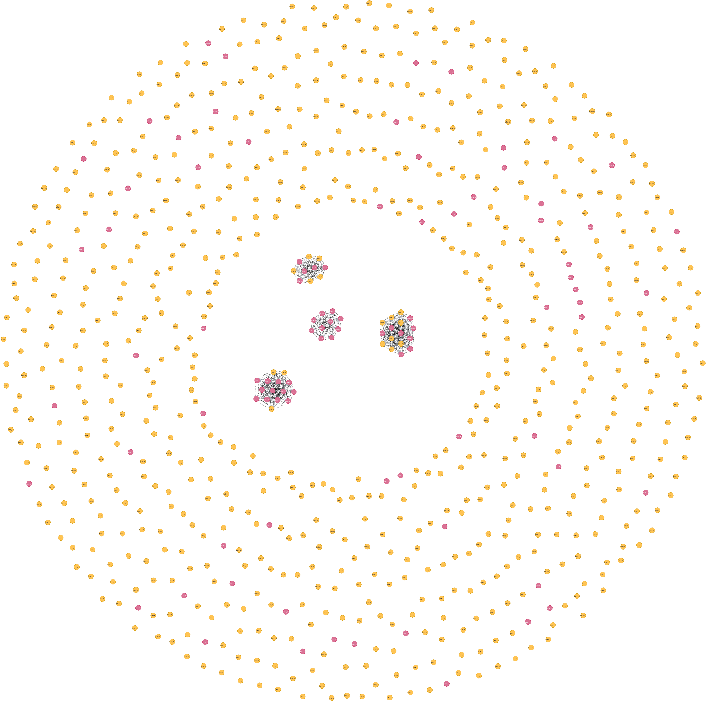
Graph Algorithm 2: Custom K-means Clustering
K-means Clustering based on early bidding frequency and auction participation
Utilized for detecting shill bidders based on exploiting their tendency to bet earlier in auctions than other bidders
Interior Cluster: Predicted to be Shill Bidders. Tight interconnectivity. (All small interior communities are part of single Predicted Shill cluster)
Exterior Cluster: Predicted to be Non-Shill Bidders
Orange Nodes - Actual Non-Shill Bidders
Red nodes - Actual Shill Bidders
RESULTS | Not Actual Shill | Actual Shill
Not Predicted Shill | 1312 | 39
Predicted Shill | 85 | 41
Notes:
Micah present
We actually created our own rendition of K-means clustering.
We custom crafted a clustering algorithm based on what we know about shill-bidder behaviors- that being they tend to bid near the start of an auction, and they have high auction participation.
We categorize all bidders as being either predicted shill bidders, or not predicted shill bidders.
In the interior cluster we can see different rings of bidders who are predicted to be shills.
In the exterior is everyone else that is not predicted to be shills.

Slide 13
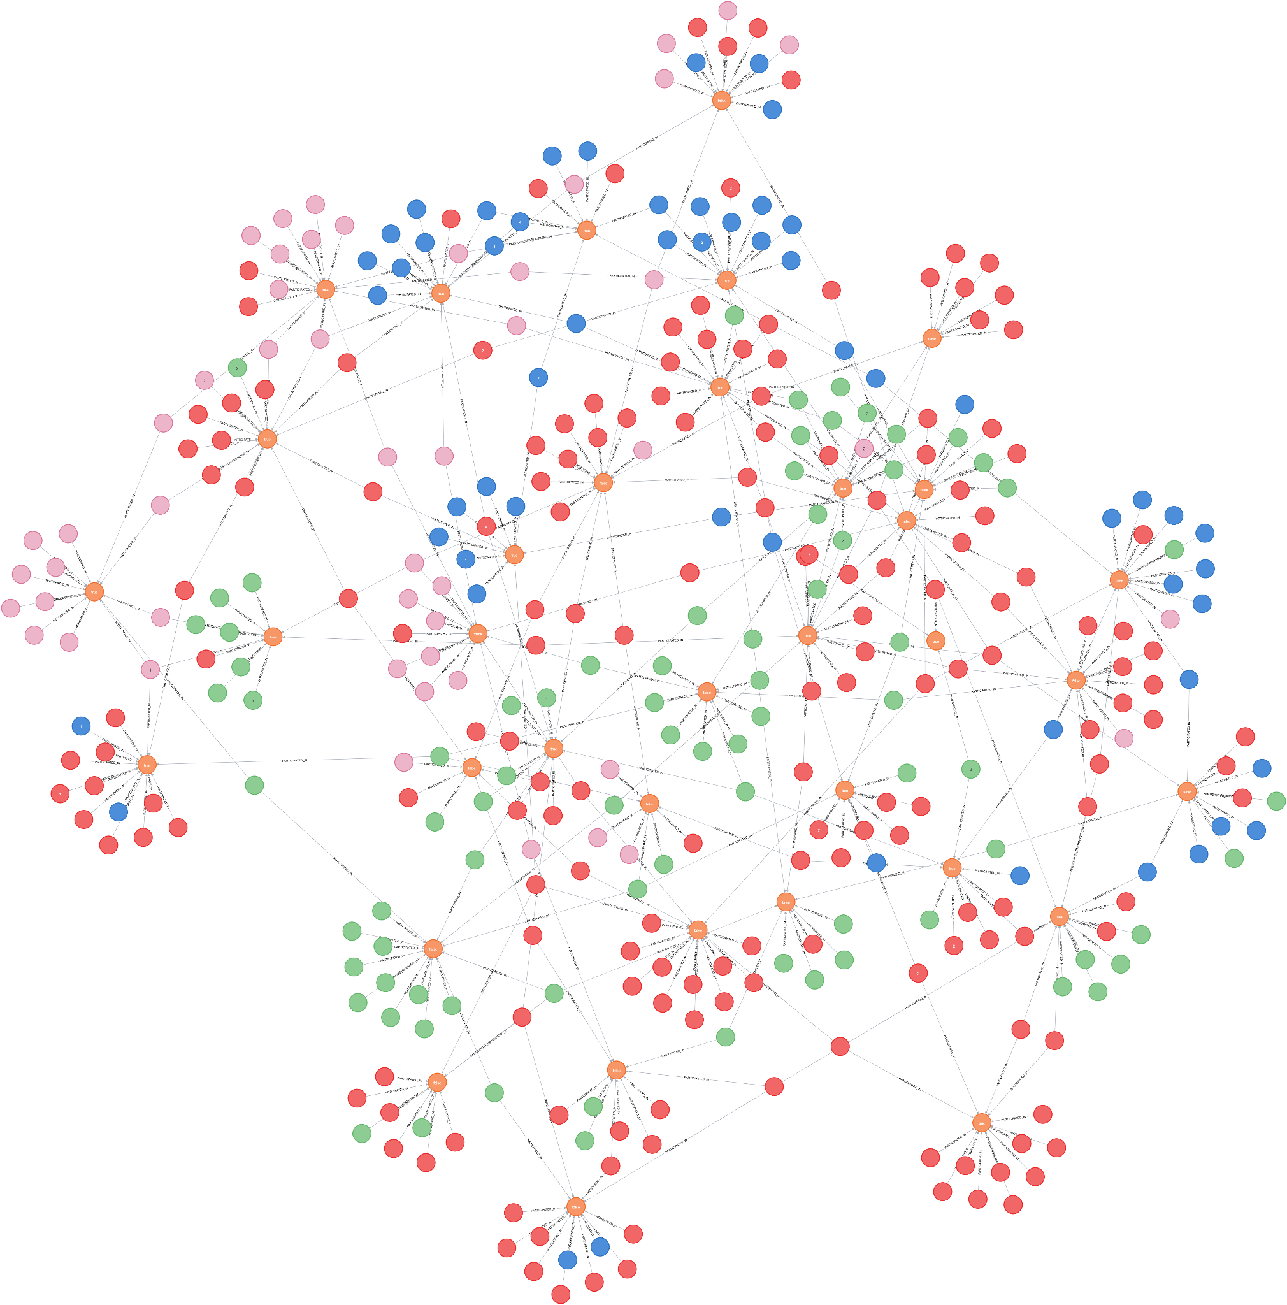
Graph Algorithm 3: Louvain Clustering
Louvain Clustering
Detects bidders groups with high co-participation rates
Co-participation defined as bidders being part of the same auction(s)
Symbolically can detect friend groups within bidding dataset
Bidder nodes of same color are part of same cluster
Notes:
Micah present Another algorithm we ran is Louvain Clustering, which we used to identify clusters of bidders who tend to be in multiple auctions with each other.
This can reflect bidders who group together and could either be bidders who are interested in the same sorts of items, or shills who collaborate with each other across multiple auctions.

Slide 14
Graph Algorithm Summary
Graph Algorithm | How It Works | What Suspicious Pattern It Detects | Fraud Detection Insight
Degree Centrality | Measures how many connections (bids) a bidder has in the auction graph. | Bidders with many bid connections but zero wins – possible price inflators, not buyers. | Flags highly active bidders whose behavior deviates from normal winner patterns.
K-Means Clustering | Groups bidders based on behavioral features: bid frequency, timing, win ratio, etc. | Detects clusters of similarly abnormal behavior, e.g., early-bidding frequency or last-minute sniping or over-bidding. | Helps categorize behavioral outliers for further investigation.
Louvain Clustering | Detects tightly connected communities based on shared auction participation. | Reveals bidder rings that frequently bid together – strong sign of coordinated shill groups. | Identifies hidden collusion networks among bidders to manipulate auction outcomes.
Notes:
Micah present
Degree centrality measures how many outgoing bids each bidder has across all of the auctions they are participating in.
This lets us see highly active bidders, and we can can go further by looking at active bidders with zero wins to detect shill bidders.
K-means clustering detects clusters of a specified behavior, in our case, we are clustering for high early bidding frequency.
This allows us to cluster together bidders with shill behavior
Louvain Clustering detects tightly connected communities based shared auction participation.
This helps reveal bidder rings that frequently bid together or even hidden collusion networks.

Slide 15
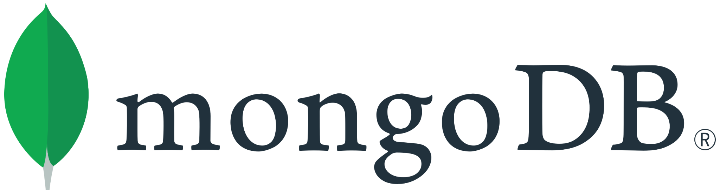
for Flexible Storage of Auction & Bidding
Why MongoDB?
✅ Schemaless NoSQL database
✅ Supports semi-structured & hierarchical documents (BSON/JSON)
✅ Ideal for nested bidding history, variable bidder attributes, and evolving auction schemas
Advantages Over Relational Databases
✅ No need for rigid schemas, foreign keys, or join tables
✅ Easily stores embedded documents like bids inside auctions
✅ Optimized for rapidly changing, high-volume data
✅ Better performance for read-heavy workloads with indexed collections
Use Case: Online Auction Platform
Store complete auction metadata in one document:
Auction ID, price, date, item details
Embedded list of bids (bidder ID, timestamp, amount)
Bidder profile info inline or via references
Final winner and transaction summary
RDBMS Limitations for This Use Case
Requires complex schema design: normalization, foreign key constraints
Needs multiple join operations for auction + bid + bidder queries
Harder to scale horizontally for real-time auction systems

Slide 16

for Real-Time Bidding and Concurrent Updates
Why Redis?
✅ In-memory key-value store optimized for speed
✅ Excellent for high-throughput, low-latency operations
✅ Acts as cache layer or primary store for fast-changing data
Ideal for Real-Time Auctions
✅ Handles frequent, concurrent writes (e.g., many bidders submitting bids simultaneously)
✅ Supports atomic operations to prevent race conditions
✅ Enables real-time updates to bid status, countdown timers, and current leaders
Use Case: Online Live Bidding System
High-speed bid submission and validation
Store latest bid state, leading bidder, auction timer
Push updates to front-end using Redis Pub/Sub or Streams
RDBMS Limitations for This Use Case
Performance bottlenecks under write-heavy loads
Complex transaction management for concurrent updates
Slower I/O due to disk-based storage and locking

Slide 17
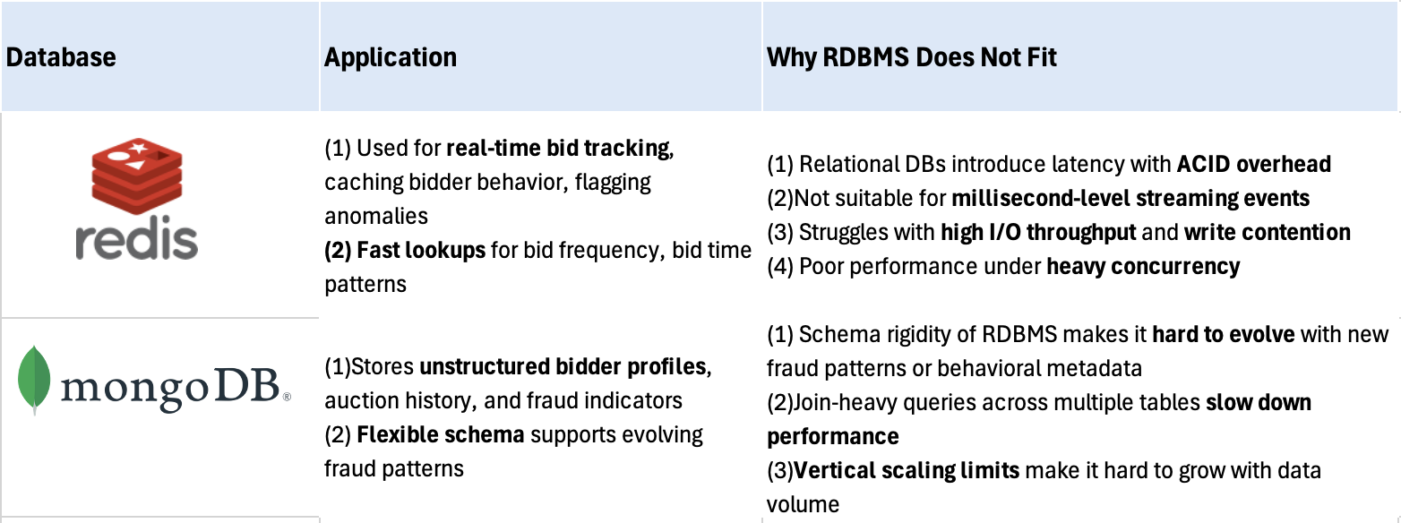
Why NoSQL Outperforms RDMS in Online Fraud Detection
Redis & MongoDB help by:
MongoDB: Ingesting and analyzing diverse bidder activity and metadata (e.g., bid times, auction participation, clustering scores)
Redis: Powering real-time detection for sniping behavior or shill bidding rings using fast in-memory access

Slide 18
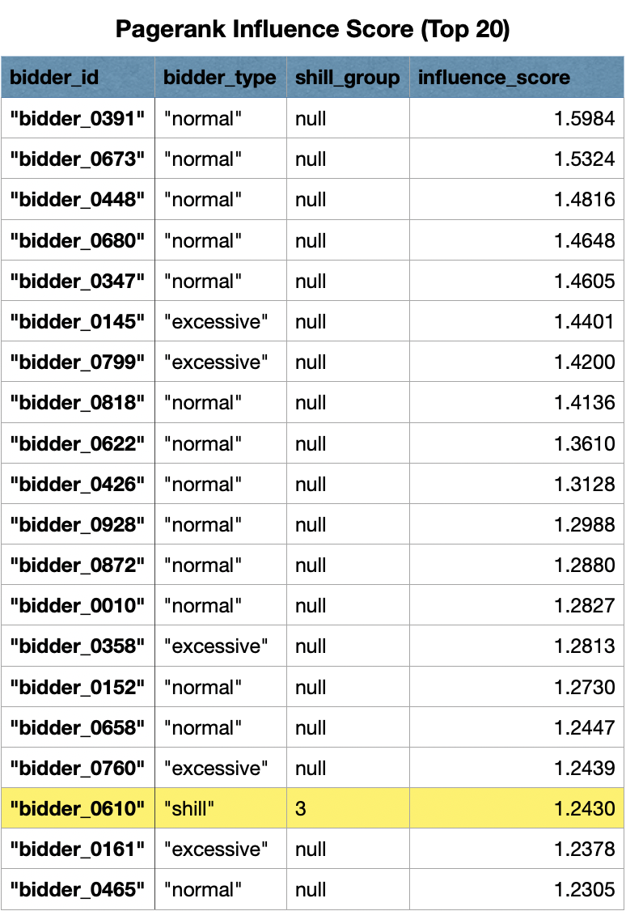
Additional Analysis – PageRank Influence Score
Key Observations:
Top influential bidders are primarily normal bidders and excessive bidders
Only one shill bidder (bidder_0610 from group 3) appearing in the top 20
Aligned with Actual Online Marketplaces
Popular Bidders: Normal and excessive bidders top the influence charts by naturally participating across diverse auctions due to genuine interests in various product
Isolated Shill Networks: Shill bidders operate in smaller, focused clusters around specific sellers they're colluding with
Bridge Accounts: One shill bidder (bidder_0610) made the top 20 - representing the key "bridge" accounts fraud rings use to maintain connections
Detection Power: PageRank complements our other graph algorithm analysis, creating a multi-layered detection system that catches sophisticated fraud rings traditional methods miss

Slide 19
Conclusion
We simulated realistic auction data to model bidder behaviors, including normal, excessive, and shill bidders.
Using graph databases (Neo4j) and algorithms like Degree Centrality, K-Means Clustering, and Louvain Community Detection, we successfully:
o Identified suspicious bidding patterns
o Detected collusive rings among bidders
o Flagged high-risk non-winning, high-activity participants
MongoDB enabled flexible storage and analysis of diverse, evolving auction metadata.
Redis powered real-time fraud tracking, supporting live bid monitoring and prevention of race conditions.
Relational databases were shown to be less effective due to schema rigidity, poor concurrency support, and limited scalability for this use case.

Slide 20
Limitations and Future Research
Limitations:
❌ No auction price or bid amount data — limits financial impact analysis
❌ Simulated dataset — lacks real-world complexity or behavioral noise
❌ No seller information — cannot detect collusion with sellers
❌ Known shill bidders manually assigned — no historical fraud labels
Future Research:
📈 Incorporate price and bid increment data to assess manipulation severity
🔄 Use real auction datasets (e.g., eBay, etsy) for validation
🧩 Expand graph to include seller-bidder relationships
🤖 Apply supervised ML with labeled fraud cases to improve detection accuracy

Slide 21
References
https://neo4j.com/blog/developer/exploring-fraud-detection-neo4j-graph-data-science-summary/
https://neo4j.com/blog/fraud-detection/neo4j-aws-fraud-detection/
https://neo4j.com/blog/fraud-detection/enterprise-fraud-detection/
https://link.springer.com/content/pdf/10.1007/978-3-319-23461-8_11.pdf?pdf=inline+link
https://medium.com/paypal-tech/how-paypal-uses-real-time-graph-database-and-graph-analysis-to-fight-fraud-96a2b918619a
https://medium.com/cloud-native-daily/building-a-fraud-detection-system-for-ecommerce-websites-using-graph-databases-9a84d0ffa8de
https://www.mongodb.com/
https://redis.io/lp/get-started2/?utm_campaign=gg_s_core_amert1_en_brand_acq_21168833255&utm_source=google&utm_medium=cpc&utm_content=redis_exact&utm_term=&gad_source=1&gbraid=0AAAAADg3Ge-Uc2sRO0G9YU7yumcPi5c4H&gclid=Cj0KCQjwzYLABhD4ARIsALySuCTt6RbivsBUcEFaZdTromTogXRvKzlQyVxzsHl4A4wHD9POBdwejyUaAjNBEALw_wcB

Slide 22
Q&A
Thank you for your time and attention!
If you have any follow-up questions or would like to learn more about our project and Neo4j,
please feel free to contact the project lead:
Min Yang
📧 yangmindc@berkeley.edu

